Slide 1
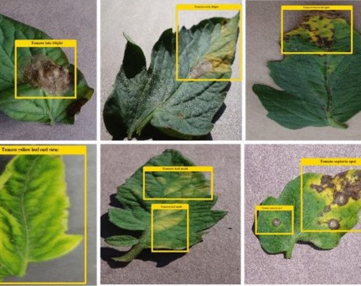

Plant Disease Identification Data Story
Presented by: Group 1
PG Level Advanced Certification Programme in AI and MLOps

Slide 2
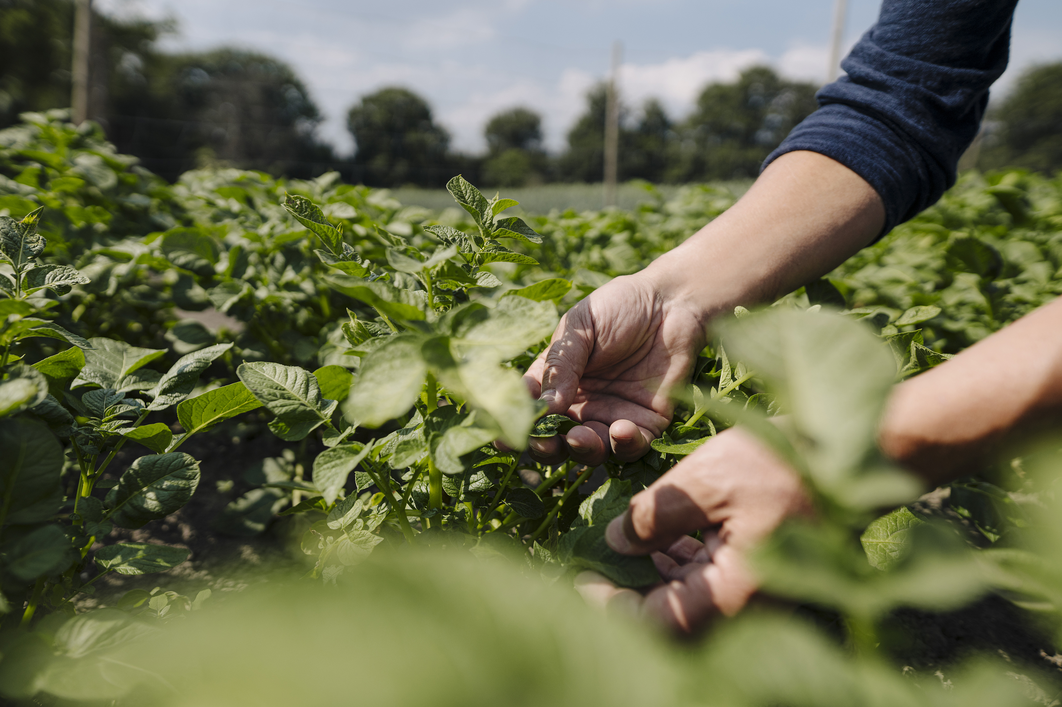
Importance of Plants
They provide us with a variety of
things
food to eat,
air to breathe,
clothes to cover our body,
wood,
medicine,
shelter,
and many products for human benefit.
Plants are the primary producers, and all other living organisms on this planet depend on plants.

Slide 3
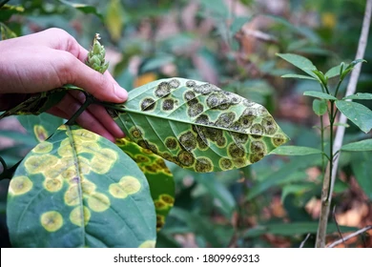
Impact of Plant Disease
Globally about 30% of food production is impacted by diseases to plant resulting in billions of dollars of business loss to farming community
Food shortages caused by plant diseases and pests can increase prices, lead to food insecurity and poor diets, and trigger civil unrest in vulnerable countries.

Slide 4
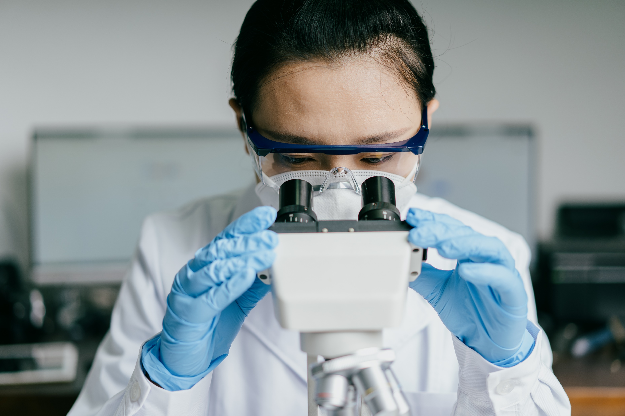
Disease Detection
Common methods for the diagnosis and detection of plant diseases include by human inspection, microscopic evaluation of morphology features to identify pathogens, as well as molecular, serological, and microbiological diagnostic techniques

Slide 5
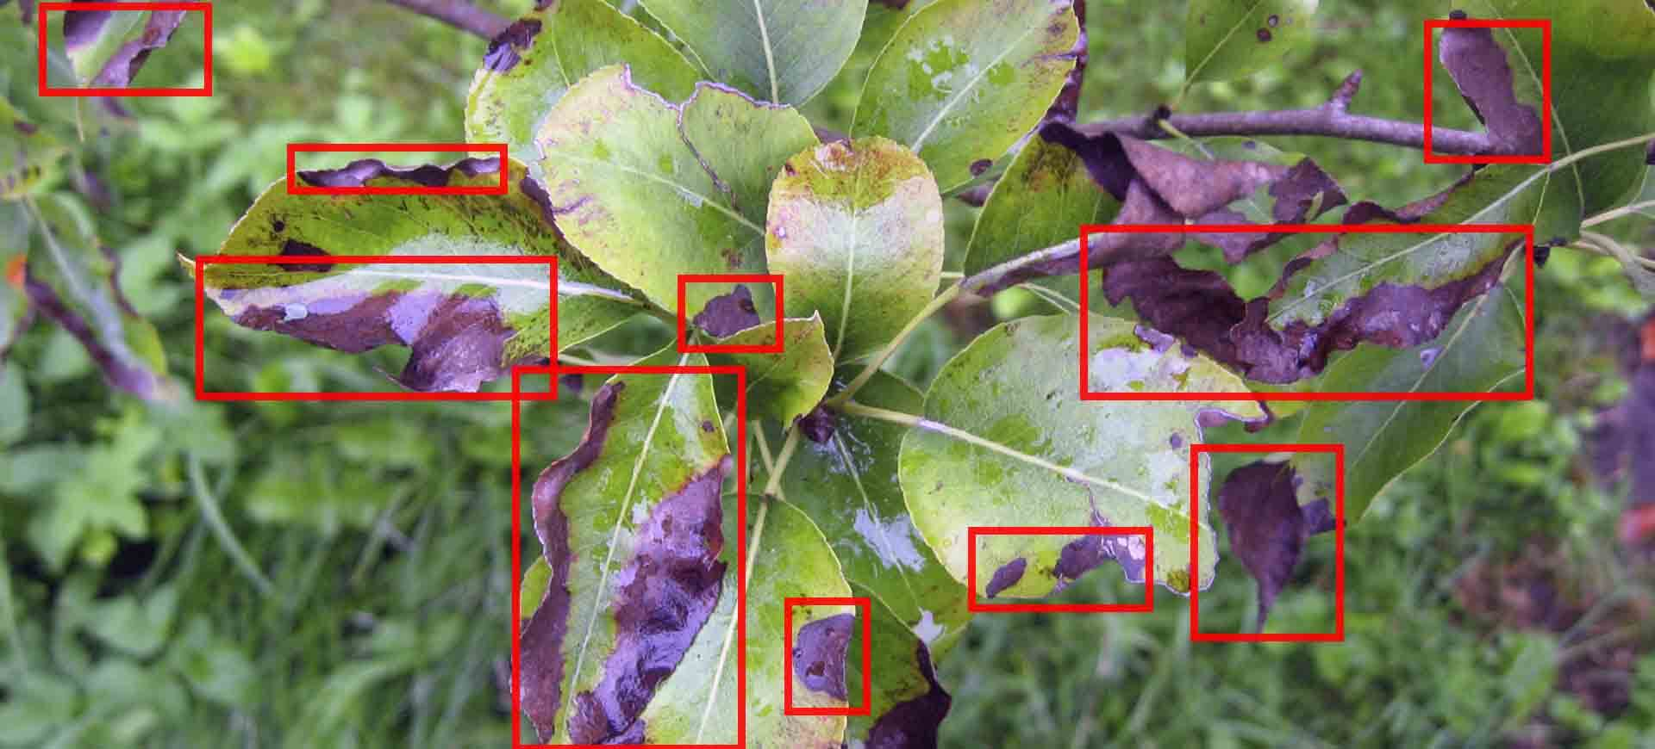
New Age Disease Detection Techniques

